Slide 1
Schools and Medicaid Quarterly Call
August 24, 2017

Slide 2
Agenda
Introductions - AHCA and FDOE/SSS staff
FFS - Lakera/Luc
- Revisions/SPA status - Lakera/Luc
(FFS, charter/private schools/free care guidance)
- NCCI changes and denials and dates of changes
- Fee schedule dated 1/1/17 revisions
- Medical Necessity
- Rule process
SDAC - Ami
- Claiming salaries and benefits
- Payroll documentation
- Distinction between SDAC codes 5, 9, 10
- Staff included in sample
Notes:
Anne-Start Introductions-self, TJ, Richard
Luc-AHCA staff
Anne-run through agenda

Slide 3
Agenda (cont’d)
FDOE/SSS Update-Anne
- Updated participation report will be sent to districts for completion by October 31.
Parental Consent Reminder
NAME Conference-Deneen Gorassini, Conference Chair, Broward County school district
Open Forum-Call attendees enter questions in chat box

Slide 4
Fee for Service: Rule Revisions/SPAs - Status
Medicaid Certified School Match Handbook (2005)
Private/Charter Schools
Rules related to CMS Free Care guidance
Notes:
Luc/Lakera

Slide 5
Fee for Service-National Correct Coding Initiative (NCCI)
Refresher from last call:
NCCI – Developed by CMS to promote national correct coding methodologies and to control improper coding leading to inappropriate payments.
MUE - NCCI includes a set of edits known as Medically Unlikely Edits (MUEs). An MUE is a maximum number of Units of Service allowable under most circumstances for a single Healthcare Common Procedure Coding System/Current Procedural Terminology (HCPCS/CPT) code billed by a provider on a date of service for a single beneficiary.
Notes:
Luc/Lakera

Slide 6
Fee for Service-Denied Claims/New Procedure Codes
Denied claims with units over maximum number in NCCI edits:
-If over maximum units, entire claim will deny
-District must resubmit the claim with a total number of units at or below the NCCI edit number
-Most common procedure code asked about by districts=96150 (Behavioral-Individual Service-Evaluation-8 units)
Notes:
Luc/Lakera

Slide 7
Medical Necessity
Florida Statute 409.013(2)(d): “Medical necessity” or “medically necessary” means any goods or services necessary to palliate the effects of a terminal condition, or to prevent, diagnose, correct, cure, alleviate, or preclude deterioration of a condition that threatens life, causes pain or suffering, or results in illness or infirmity, which goods or services are provided in accordance with generally accepted standards of medical practice. For purposes of determining Medicaid reimbursement, the agency is the final arbiter of medical necessity. Determinations of medical necessity must be made by a licensed physician employed by or under contract with the agency and must be based upon information available at the time the goods or services are provided.
Notes:
Luc/Lakera

Slide 8
Medical Necessity
AHCA has not issued guidance beyond statutory definition, so up to school district providers to determine if service provided is medically necessary based on definition.
Notes:
Luc/Lakera

Slide 9
Medicaid Fee Schedules Effective 1/1/17
Medicaid Health Care Alert 2/7/17-Fee Schedules
http://ahca.myflorida.com/medicaid/review/fee_schedules.shtml
Sign up for Medicaid Health Care Alerts
http://ahca.myflorida.com/Medicaid/alerts/alerts.shtml
Fee schedule in process of review and correction
Notes:
Luc/Lakera

Slide 10
Why Create Rules?
Why Do Agencies Create Rules?
Laws do not always provide the necessary level of detail. Agencies draft rules to provide detail.
Notes:
Lakera

Slide 11
Rule Workshops and Proposed Rules
Rule Workshops and Proposed Rules are published in the Florida Administrative Register (FAR).
Workshops and hearings are typically held in one of the Agency's conference rooms at Fort Knox Building 3, 2727 Mahan Drive, Tallahassee.
Workshop: Scheduled so that interested parties may provide informal advice and comments about the rule.
Public Hearing: More formal process for interested parties to present testimony or documents about the rule content.
If the Agency elects to modify the rule in response to the hearing testimony or other materials submitted, the revised text will be published in the Florida Administrative Register as a Notice of Change.
Additional detail about the rule adoption process is found in Chapter 120, Florida Statutes and Chapter 1B-30.001, Florida Administrative Code.
Notes:
Lakera

Slide 12
Notes:
Lakera: You will receive a Medicaid Health Care Alert letting you know there will be a hearing or workshop on the rule. Go to the FAR web site. This is an example of Notice for Public Hearing.

Slide 14
Notes:
You can then look at the AHCA Rules web page for any reference material.

Slide 15
Notes:
Lakera -Rules in Process page: Click on the applicable rule document

Slide 16
SDAC
Claiming salaries and benefits
- Payroll documentation
-requesting payroll on more regular basis and it
-provide to AHCA in Excel format
Staff included in sample
- Non-Federally funded salaries and benefits only
Notes:
Ami

Slide 17
SDAC Codes 5, 9, 10
Code 5: Care Planning and Coordination for Medical/Mental Health Services:
This activity occurs generally when staff are:
•coordinating and/or monitoring the delivery of medical/mental health services, and
•linking the student and family with Medicaid service providers to plan, carry out and maintain a health service plan
Notes:
Ami

Slide 18
SDAC Coding 5,9,10
Code 9: Program planning, Development and Monitoring
These are activities associated with the development of strategies to improve the coordination and delivery of medical/mental health services to school age children. The activities include developing, monitoring and maintaining tracking systems to assess the effectiveness of these services and programs.
Notes:
Ami

Slide 19
SDAC Coding 5,9,10
Code 10: Direct Medical and School Health-
Related Services:
This activity is applicable when staff are providing direct medical care, counseling and therapeutic services or treatment. The activity includes screening, evaluations and treatment.
Notes:
Ami

Slide 20
SSS Website-Medicaid pages
SSS Website http://sss.usf.edu/resources/topic/medicaid/index.html
Parental Consent Forms translated-Spanish and Creole
Reminder: Send information for sharing with other districts
Notes:
Anne

Slide 21
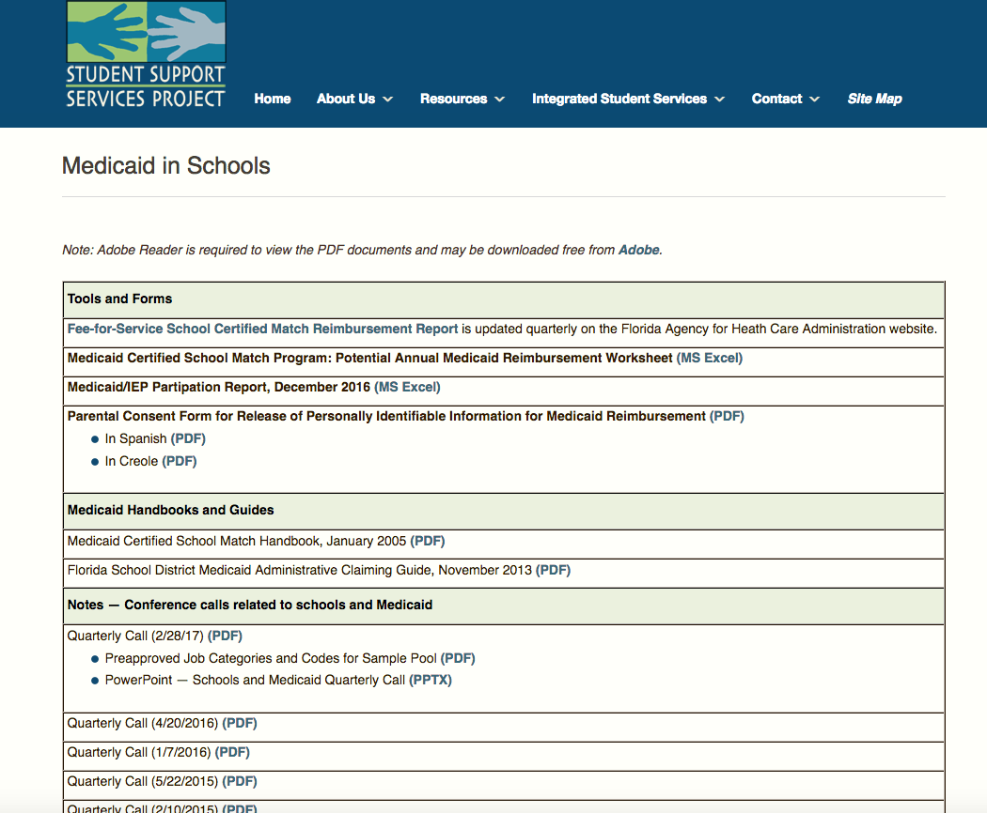
Notes:
Anne

Slide 22
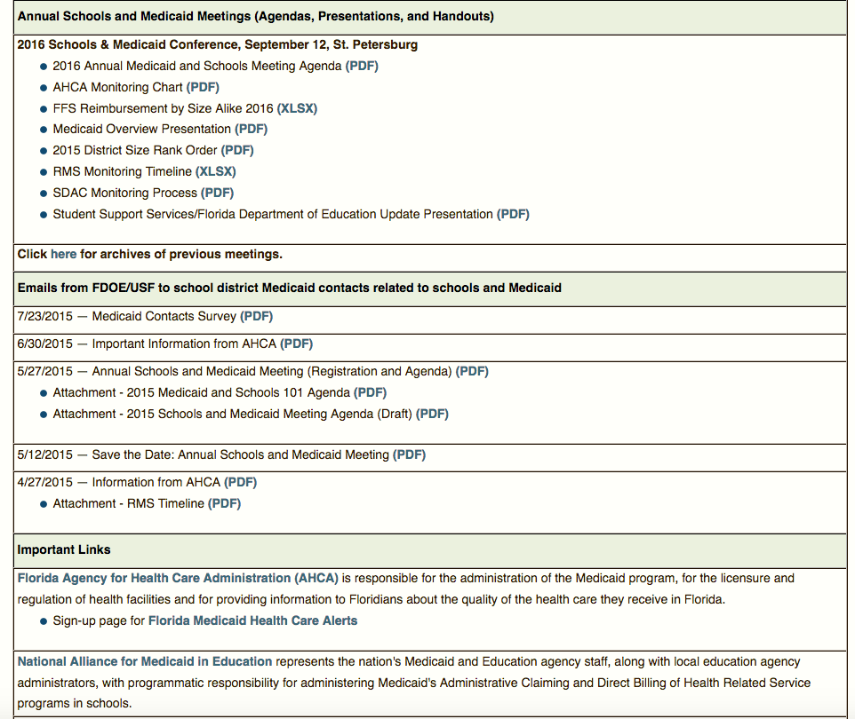
Notes:
Anne

Slide 23
Notes:
Anne

Slide 24
Parental Consent/Notification Reminder
Parental Consent one time
Notification annually
Addressed in Florida Administrative Code 6A-6.03028(3)(q) Procedures for students with disabilities who are covered by public benefits or insurance
Notes:
Anne-If you have questions, contact Anne. IDEA Q and A available and example forms on SSS website.

Slide 25
Parental Consent
d. Prior to accessing the student’s or parent’s public benefits or insurance for the first time, and after providing notification to the student’s parent as described in sub-subparagraph e. of paragraph (3)(q), the school district must obtain written, parental consent that specifies:
(I) The personally identifiable information that may be disclosed such as records or information about the services that may be provided to the student;
(II) The purpose of disclosure, such as for purpose of billing for services;
(III) The agency to which the disclosure may be made; and,
(IV) That the parent understands and agrees that the school district may access the parent’s or student’s public benefits or insurance to pay for services required under Rules 6A-6.03011-.0361, F.A.C.
e. Prior to accessing a student’s or parent’s public benefits or insurance for the first time, and annually thereafter, the school district must provide written notification consistent with the requirements found in paragraphs 6A-6.03311(1)(a) and (b), F.A.C., to the student’s parents that includes:
(I) A statement of the parental consent provision in sub-subparagraph d. of this paragraph;
(II) A statement of the no cost provisions of subparagraph (3)(q)1.;
(III) A statement that the parents have the right to withdraw their consent to disclose their child’s personally identifiable information to the agency responsible for the administration of the State’s public benefits or insurance at any time; and,
(IV) A statement that the withdrawal of consent or refusal to provide consent to disclose personally identifiable information to the agency responsible for the administration of the State’s public benefits or insurance program does not relieve the school district of its responsibility to ensure that all required services are provided at no cost to the parents.

Slide 26
Annual Notification
e. Prior to accessing a student’s or parent’s public benefits or insurance for the first time, and annually thereafter, the school district must provide written notification consistent with the requirements found in paragraphs 6A-6.03311(1)(a) and (b), F.A.C., to the student’s parents that includes:
(I) A statement of the parental consent provision in sub-subparagraph d. of this paragraph;
(II) A statement of the no cost provisions of subparagraph (3)(q)1.;
(III) A statement that the parents have the right to withdraw their consent to disclose their child’s personally identifiable information to the agency responsible for the administration of the State’s public benefits or insurance at any time; and,
(IV) A statement that the withdrawal of consent or refusal to provide consent to disclose personally identifiable information to the agency responsible for the administration of the State’s public benefits or insurance program does not relieve the school district of its responsibility to ensure that all required services are provided at no cost to the parents.

Slide 27
NAME Conference
October 15-18, 2017
Fort Lauderdale, FL
Notes:
Deneen

Slide 28
Open Forum
Phone will be taken off of presentation mode-please mute your phone line if you are not speaking.
If you have comments or questions, please identify yourself and your district.
Notes:
Anne

